Slide 1

Quick Cart App. Spray paint the Eiffel tower
Created by: Strange Energy

Slide 2

Last time we discussed

Slide 3

About Quick Cart
The Quick Cart application was created to aid users in their shopping experience, allowing users to accomplish two main tasks:
Locate items while shopping in store
Order items through the app and pick up an already packed and ready bag in store.
The application accomplishes this through the use of MySQL and SQLite databases.

Slide 4

Key Features
Login/Sign up
Allows new users to create an account and sign in to the application.
Database
Contains user and item information.
Community(Powered by Flask)
Will be discussed Friday

Slide 5


Key Features Continued
Locate
Allows in store users to search for items which the application then displays the items location.

Slide 6



Key Features Continued
Shopping
Allows users to shop from home by selecting items and adding them to their cart. Upon checkout a QR code is generated which the user will present upon in store collection.

Slide 7
Future Implementations
An application is never truly complete!
In app payment
GPS to nearest Quick Cart powered store
To support delivery
Coupon implementation
Time Specification

Slide 8
Let’s see a LIVE DEMO!

Slide 9
About Quick Cart Blog – powered by FLASK
The Quick Cart Blog is a website that allows for users to view posts and recipes made by the Quick Cart admins and add recipes themselves.

Slide 10
Key Features
Login/Sign up
Allows new users to create an account and sign in to the website. Bycrypt and flask_login
Database
Contains user, post and recipe information using SQLAlchemy.
Blog Functionalities
Add posts, recipes.
Update posts, recipes.
Delete posts, recipes.
User type specification.
Retrieve all your posts and or recipes.

Slide 11
Add posts, recipes
Utilizes flasks WTForms to generate forms which the user then uses to submit data. Also uses WTForms.validators to ensure that specifications are met.

Slide 12
Update posts, recipes
Utilizes flasks WTForms to generate forms which the user then uses to submit data. Also uses WTForms.validators to ensure that specifications are met.

Slide 13
Delete posts, recipes
Queries the database and deletes a post/recipe based on its ID.

Slide 14
User type specification
Shows certain features when an admin is using the site. Utilizes flask_login.

Slide 15
Retrieve all your posts and or recipes
Queries the database and shows all posts and or recipes made by the current user. Utilizes flask_login.

Slide 16
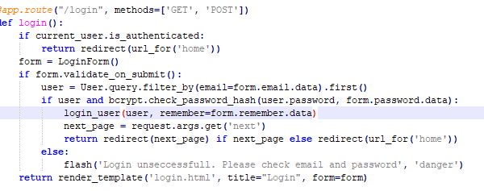
Code snip

Slide 17
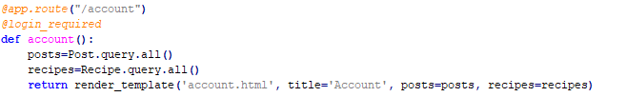
Code snip

Slide 18
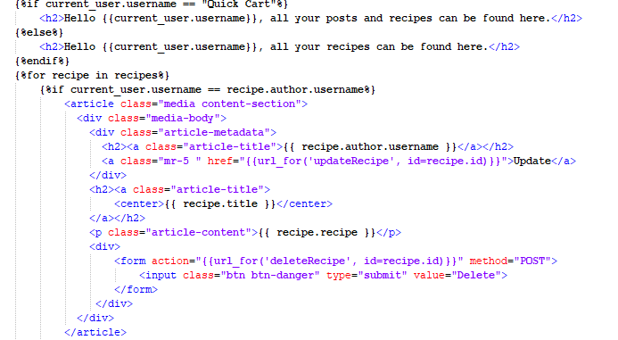
Code snip

Slide 19
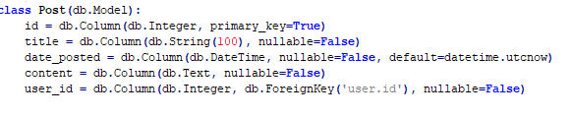
Code snip

Slide 20
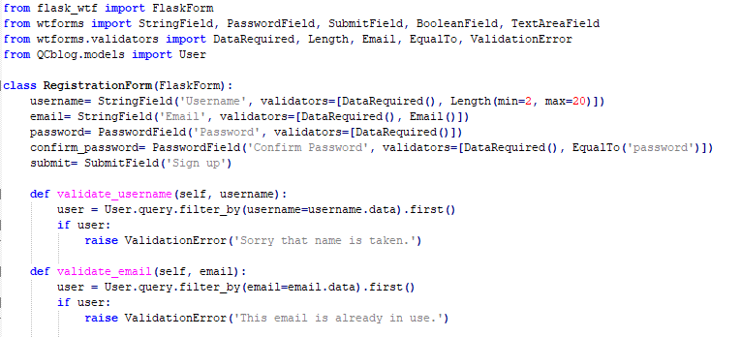
Code snip

Slide 21
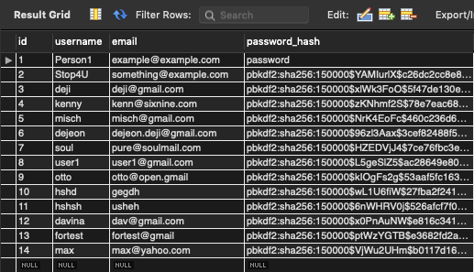
MySQL DB (app)

Slide 22
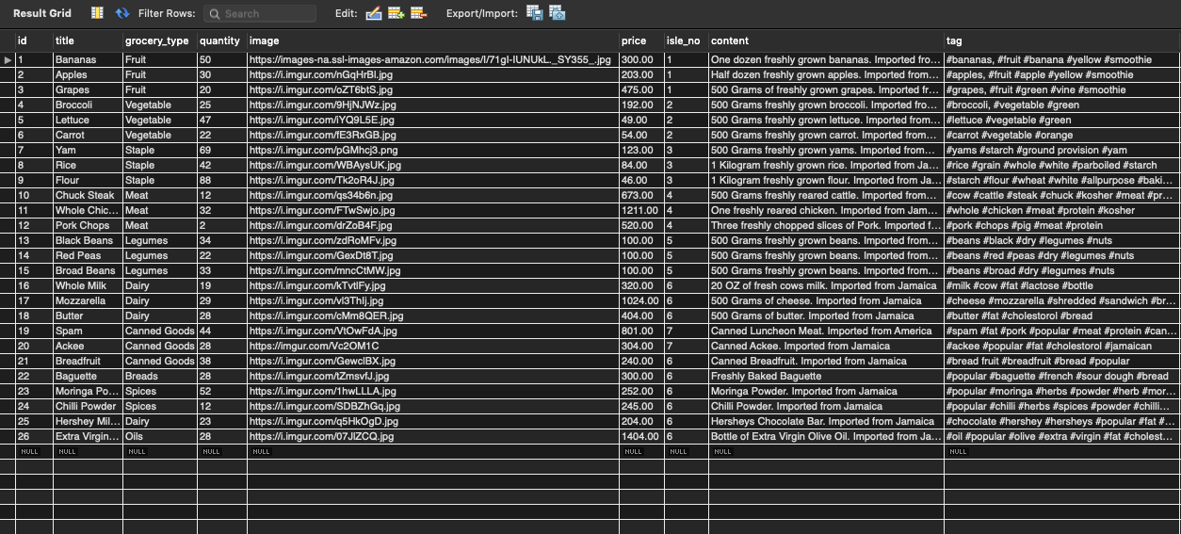
MySQL DB (app)

Slide 23
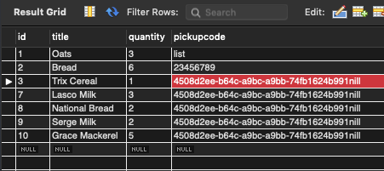
MySQL DB (app)

Slide 24
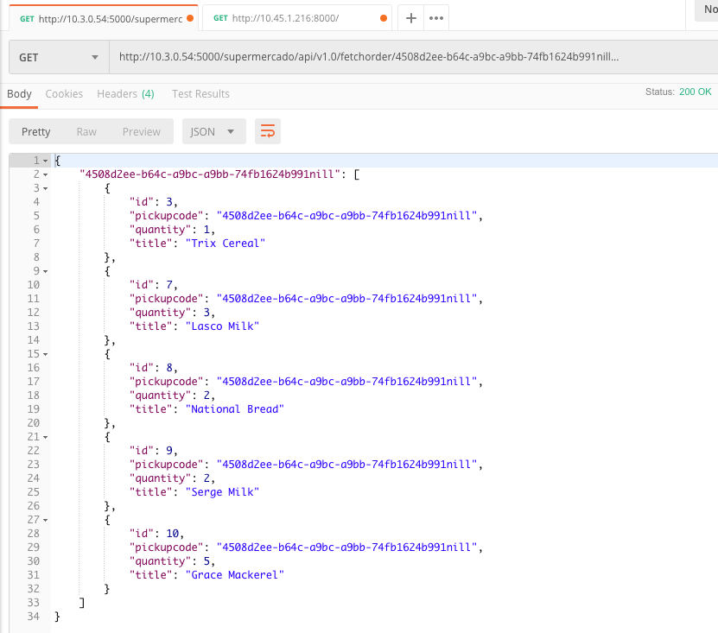
MySQL DB (app)

Slide 25
Let’s see a LIVE DEMO!

Slide 26

Thank You!
Any Questions?

